Slide 1
Solving Problem by Searching
Informed Search

Slide 2
Outline
Informed = use problem-specific knowledge
Which search strategies?
Best-first search and its variants
Heuristic functions?
How to invent them
Local search and optimization
Hill climbing, local beam search, genetic algorithms,…
Local search in continuous spaces
Online search agents

Slide 3
Informed Search
Informed searches use domain knowledge to guide selection of the which path is best to continue searching.
Informed guesses, called heuristics, are used to guide the path selection.
Heuristic means "serving to aid discovery".
All of the domain knowledge used to search is encoded in the heuristic function h.

Slide 4
Informed Search
Define a heuristic function, h(n):
uses domain-specific information in some way
is computable from the current state description
it estimates:
the "goodness" of node n
how close node n is to a goal
the cost of minimal cost path from node n to a goal state
h(n) >= 0 required for all nodes n
h(n) = 0 implies n is a goal node
h(n) = infinity implies n is a dead end from which a goal cannot be reached

Slide 5
Previously: Tree-search
function TREE-SEARCH(problem, frontier) return a solution or failure
frontier ← INSERT(MAKE-NODE(problem.INITIAL-STATE), frontier)
loop do
if EMPTY?(frontier) then return failure
node ← REMOVE-FIRST(frontier)
if problem.GOAL-TEST(node.STATE) succeeds
then return SOLUTION(node)
frontier ← INSERT-ALL(EXPAND(node, problem), frontier)
end
A strategy is defined by picking the order of node expansion

Slide 6
Best-first search
A generic way of referring to the class of informed search methods.
Idea: node is selected for expansion based on an evaluation function f(n)
estimate of "desirability"
Expand most desirable unexpanded node
Implementation: Order the nodes in frontier in decreasing order of desirability
Special cases:
greedy best-first search
A* search

Slide 7
Greedy best-first search
One of the simplest best-first search strategies is to minimize the estimated cost to reach the goal
Evaluation function f(n) = h(n) (heuristic)
[dictionary] “A rule of thumb, simplification, or educated guess that reduces or limits the search for solutions in domains that are difficult and poorly understood.”
estimated cost of the cheapest path from n to goal
Greedy best-first search expands the node that appears to be closest to goal, e.g.
h_{SLD}(n) = straight-line distance from n to Bucharest
If n is goal then h(n)=0
Expand node that is closest to goal: h(n) → min

Slide 8
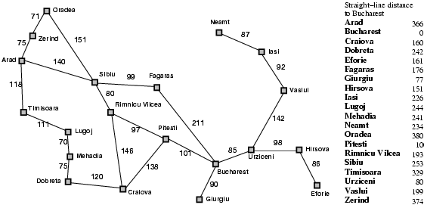
Romania with step costs in km

Slide 9

Greedy best-first search example
Assume that we want to use greedy search to solve the problem of travelling from Arad to Bucharest.
The initial state=Arad

Slide 10
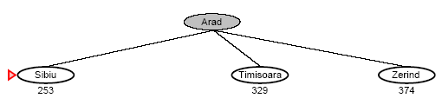
Greedy best-first search example
The first expansion step produces:
Sibiu, Timisoara and Zerind
Greedy best-first will select Sibiu.

Slide 11
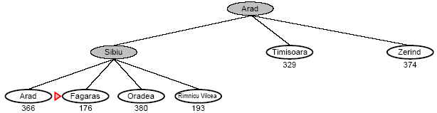
Greedy best-first search example
If Sibiu is expanded we get:
Arad, Fagaras, Oradea and Rimnicu Vilcea
Greedy best-first search will select: Fagaras

Slide 12
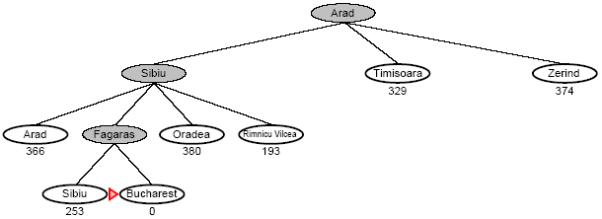
Greedy best-first search example
If Fagaras is expanded we get:
Sibiu and Bucharest
Goal reached !!
Yet not optimal (see Arad, Sibiu, Rimnicu Vilcea, Pitesti)

Slide 13
Properties of greedy best-first search
Complete? No – can get stuck in loops
e.g., Iasi → Neamt → Iasi → Neamt → ...
Complete in finite space with repeated-state checking
Time? O(b^{m}), but a good heuristic can give dramatic improvement
Space? O(b^{m}) -- keeps all nodes in memory
Optimal? No

Slide 14
A*: Best-known form of best-first search
Idea: avoid expanding paths that are already expensive.
Evaluation function f(n) = g(n) + h(n)
g(n) the path cost from start node (so far) to node n.
h(n) estimated cost to get from node n to the goal.
f(n) estimated total cost of path through n to goal.
A* search uses an admissible heuristic h(n)
A heuristic is admissible if it never overestimates the cost to reach the goal
h(n) <= h*(n) where h*(n) is the true cost from n to goal
h(n) >= 0 so h(G)=0 for any goal G.
e.g. h_{SLD}(n) never overestimates the actual road distance
If h is admissible, f(n) never overestimates the actual cost of the best solution through n

Slide 15

A* search example
Find Bucharest starting at Arad
f(Arad) = c(??, Arad) + h(Arad) = 0 + 366 = 366

Slide 16

A* search example
Expand Arrad and determine f(n) for each node
f(Sibiu) = c(Arad, Sibiu) + h(Sibiu) = 140 + 253 = 393
f(Timisoara) = c(Arad, Timisoara) + h(Timisoara) = 118 + 329 = 447
f(Zerind) = c(Arad, Zerind) + h(Zerind) = 75 + 374 = 449
Best choice is Sibiu

Slide 17
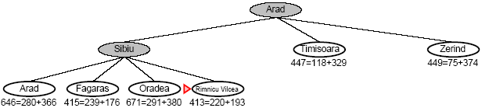
A* search example
Expand Sibiu and determine f(n) for each node
f(Arad) = g(Sibiu) + c(Sibiu, Arad) + h(Arad) = 646
f(Fagaras) = g(Sibiu) + c(Sibiu, Fagaras) + h(Fagaras) = 415
f(Oradea) = g(Sibiu) + c(Sibiu, Oradea) + h(Oradea) = 671
f(Rimnicu Vilcea)= g(Sibiu) + c(Sibiu, Rimnicu Vilcea) + h(Rimnicu Vilcea) = 413
Best choice is Rimnicu Vilcea

Slide 18
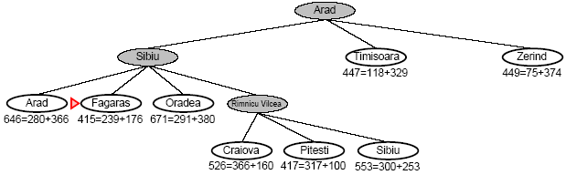
A* search example
Expand Rimnicu Vilcea and determine f(n) for each node
f(Craiova) = g(Rimnicu Vilcea) + c(Rimnicu Vilcea,Craiova) + h(Craiova) = 526
f(Pitesti) = g(Rimnicu Vilcea) + c(Rimnicu Vilcea, Pitesti)+ h(Pitesti) = 417
f(Sibiu) = g(Rimnicu Vilcea) + c(Rimnicu Vilcea, Sibiu) + h(Sibiu) = 553
Best choice is Fagaras

Slide 19
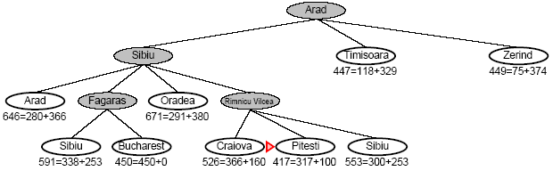
A* search example
Expand Fagaras and determine f(n) for each node
f(Sibiu) = g(Fagaras) + c(Fagaras, Sibiu) + h(Sibiu) = 591
f(Bucharest) = g(Fagaras) + c(Fagaras, Bucharest) + h(Bucharest) = 450
Best choice is Pitesti !!!

Slide 20
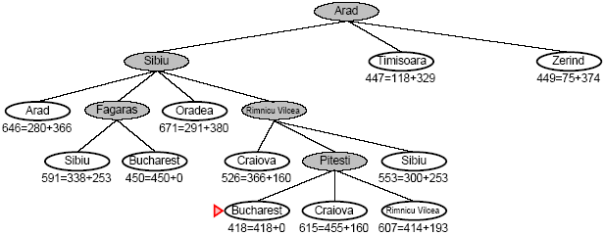
A* search example
Expand Pitesti and determine f(n) for each node
f(Bucharest) = g(Pitesti) + c(Pitesti, Bucharest) + h(Bucharest) = 418
Best choice is Bucharest !!!
Optimal solution (only if h(n) is admissable)
Note values along optimal path !!

Slide 21
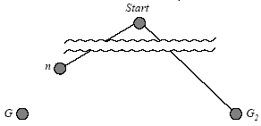
A* search is optimal - standard proof
Suppose some suboptimal goal G2 has been generated and is in the frontier.
Let n be an unexpanded node in the frontier such that n is on a shortest path to an optimal goal G
f(G2 ) = g(G2 ) since h(G2 )=0
g(G2) > g(G) since G2 is suboptimal
g(G) >= f(n) since h is admissible
Since f(G2) > f(n), A* will never select G2 for expansion

Slide 22
BUT … graph search
Discards new paths to repeated state.
Previous proof breaks down
Solution:
Add extra bookkeeping i.e. remove more expensive of two paths.
Ensure that optimal path to any repeated state is always first followed.
Extra requirement on h(n): consistency (monotonicity)

Slide 23
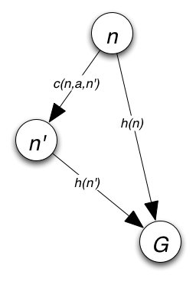
Consistent (monotonicity) heuristics
A heuristic is consistent if for every node n, every successor n' of n generated by any action a,
h(n) ≤ c(n,a,n') + h(n')
If h is consistent, we have
f(n') = g(n') + h(n') = g(n) + c(n,a,n') + h(n') ≥ g(n) + h(n) = f(n)
i.e., f(n) is non-decreasing along any path.
Theorem: If h(n) is consistent, A* using GRAPH-SEARCH is optimal

Slide 24
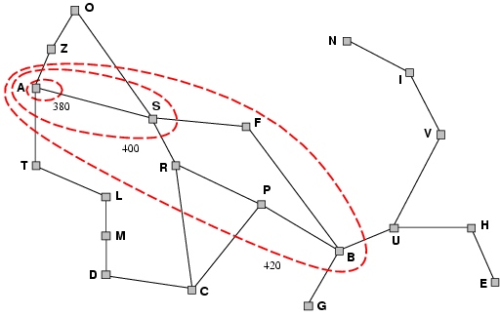
Optimality of A*
A* expands nodes in order of increasing f value
Gradually adds "f-contours" of nodes
Contour i has all nodes with f = f_{i} where f_{i} < f_{i+1}

Slide 25
A* search, evaluation
Completeness: YES
Since bands of increasing f are added
Unless there are infinitly many nodes with f<f(G)
Time complexity: O(b^{d})
Number of nodes expanded is still exponential in the length of the solution.
Space complexity: O(b^{d})
It keeps all generated nodes in memory
Hence space is the major problem not time
Optimality: YES
Cannot expand f_{i+1} until f_{i} is finished.
A* expands all nodes with f(n)< C*
A* expands some nodes with f(n)=C*
A* expands no nodes with f(n)>C*

Slide 26
Memory-bounded heuristic search
Some solutions to A* space problems (maintain completeness and optimality)
Iterative-deepening A* (IDA*)
Here cutoff information is the f-cost (g+h) instead of depth
Recursive best-first search(RBFS)
Recursive algorithm that attempts to mimic standard best-first search with linear space.
(Simple) Memory-bounded A* ((S)MA*)
Drop the worst-leaf node when memory is full

Slide 27
Recursive best-first search
function RECURSIVE-BEST-FIRST-SEARCH(problem) return a solution or failure
return RFBS(problem, MAKE-NODE(problem.INITIAL-STATE), ∞)
------------------------------------------------------------------------------------------------------
function RFBS(problem, node, f_limit) return a solution or failure and a new f-cost limit
if problem.GOAL-TEST(node.STATE) then return node
successors ← EXPAND(node, problem)
if successors is empty then return failure, ∞
for each s in successors do
f [s] ← max(g(s) + h(s), f [node])
repeat
best ← the lowest f-value node in successors
if f [best] > f_limit then return failure, f [best]
alternative ← the second lowest f-value among successors
result, f [best] ← RBFS(problem, best, min(f_limit, alternative))
if result ≠ failure then return result

Slide 28
Recursive best-first search
Keeps track of the f-value of the best-alternative path available.
If current f-values exceeds this alternative f-value than backtrack to alternative path.
Upon backtracking change f-value to best f-value of its children.
Re-expansion of this result is thus still possible.

Slide 29
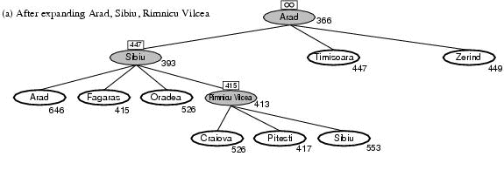
Recursive best-first search, ex.
Path until Rumnicu Vilcea is already expanded
Above node; f-limit for every recursive call is shown on top.
Below node: f(n)
The path is followed until Pitesti which has a f-value worse than the f-limit.

Slide 30
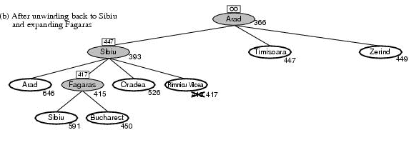
Recursive best-first search, ex.
Unwind recursion and store best f-value for current best leaf Pitesti
result, f [best] ← RBFS(problem, best, min(f_limit, alternative))
best is now Fagaras. Call RBFS for new best
best value is now 450

Slide 31
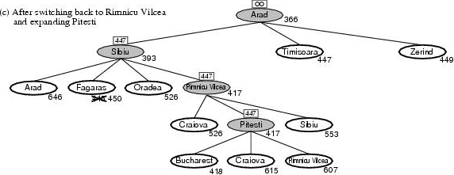
Recursive best-first search, ex.
Unwind recursion and store best f-value for current best leaf Fagaras
result, f [best] ← RBFS(problem, best, min(f_limit, alternative))
best is now Rimnicu Viclea (again). Call RBFS for new best
Subtree is again expanded.
Best alternative subtree is now through Timisoara.
Solution is found since because 447 > 417.

Slide 32
RBFS evaluation
RBFS is a bit more efficient than IDA*
Still excessive node generation (mind changes)
Like A*, optimal if h(n) is admissible
Space complexity is O(bd).
IDA* retains only one single number (the current f-cost limit)
Time complexity difficult to characterize
Depends on accuracy if h(n) and how often best path changes.
IDA* en RBFS suffer from too little memory.

Slide 33
(Simplified) Memory-Bounded A*
Use all available memory.
I.e. expand best leafs until available memory is full
When full, SMA* drops worst leaf node (highest f-value)
Like RFBS backup forgotten node to its parent
What if all leafs have the same f-value?
Same node could be selected for expansion and deletion.
SMA* solves this by expanding newest best leaf and deleting oldest worst leaf.
SMA* is complete if solution is reachable, optimal if optimal solution is reachable.

Slide 34
Learning to search better
All previous algorithms use fixed strategies.
Agents can learn to improve their search by exploiting the meta-level state space.
Each meta-level state is a internal (computational) state of a program that is searching in the object-level state space.
In A* such a state consists of the current search tree
A meta-level learning algorithm from experiences at the meta-level.

Slide 35
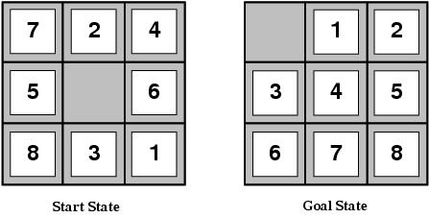
Invent Heuristic functions
E.g for the 8-puzzle
Avg. solution cost is about 22 steps (branching factor +/- 3)
Exhaustive search to depth 22: 3.1 x 10¹⁰ states.
A good heuristic function can reduce the search process.

Slide 36
Heuristic functions
E.g for the 8-puzzle knows two commonly used heuristics
h₁ = the number of misplaced tiles
h₁(s)=8
h₂ = the sum of the distances of the tiles from their goal positions (manhattan distance).
h₂(s)=3+1+2+2+2+3+3+2=18

Slide 37
Heuristic quality
Effective branching factor b*
Is the branching factor that a uniform tree of depth d would have in order to contain N+1 nodes.
N + 1 = 1 + b* + (b*)² + … + (b*)^{d}.
Measure is fairly constant for sufficiently hard problems.
Can thus provide a good guide to the heuristic’s overall usefulness.
A good value of b* is 1.

Slide 38
Heuristic quality and dominance
Typical search costs (average number of nodes expanded)
If h2(n) ≥ h1(n) for all n (both admissible) then h2 dominates h1 and h2 is better for search
Given any admissible heuristics ha(n), hb(n) h(n) = max(ha(n), hb(n)) is also admissible and dominates ha, hb

Slide 39
Admissible heuristics - Relaxed problem
A problem with fewer restrictions on the actions is called a relaxed problem
The cost of an optimal solution to a relaxed problem is an admissible heuristic for the original problem:
Relaxed 8-puzzle for h₁ : a tile can move anywhere As a result, h₁(n) gives the shortest solution
Relaxed 8-puzzle for h₂ : a tile can move to any adjacent square. As a result, h₂(n) gives the shortest solution.
The optimal solution cost of a relaxed problem is no greater than the optimal solution cost of the real problem.

Slide 40
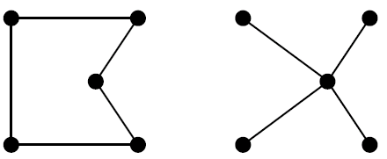
Relaxed problems (con’t)
Well-known example: Travelling Salesperson Problem (TSP)
Find the shortest tour visiting all cities exactly once
Minimum spanning tree can be computed in O(n²)
and is a lower bound on the shortest (open) tour

Slide 41
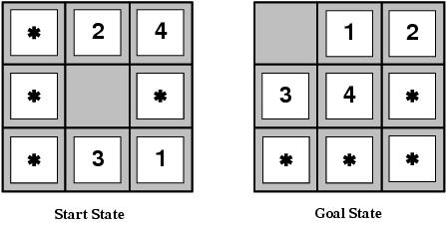
Inventing admissible heuristics
Admissible heuristics can also be derived from the solution cost of a subproblem of a given problem.
This cost is a lower bound on the cost of the real problem.
Pattern databases store the exact solution to for every possible subproblem instance.
The complete heuristic is constructed using the patterns in the DB

Slide 42
Inventing admissible heuristics
Another way to find an admissible heuristic is through learning from experience:
Experience = solving lots of 8-puzzles
An inductive learning algorithm can be used to predict costs for other states that arise during search.

Slide 43
Summary
Heuristic functions estimate costs of shortest paths
Good heuristics can dramatically reduce search cost
Greedy best-first search expands lowest h
incomplete and not always optimal
A* search expands lowest g + h
complete and optimal
also optimally eficient (up to tie-breaks, for forward search)
Admissible heuristics can be derived from exact solution of relaxed problems

Slide 44
Local search and optimization

Slide 45
Local search algorithms
In many optimization problems,
the path to the goal is irrelevant;
the goal state itself is the solution
State space = set of "complete" configurations
Find optimal configuration, e.g., Travel Saleman Problem
or, find configuration satisfying constraints,
e.g., timetable, n-queens
In such cases, we can use local search algorithms keep a single "current" state, try to improve it

Slide 46
Example: Traveling Salesperson Problem
5 City TSP (not to scale)
A salesman wants to visit a list of cities
stopping in each city only once
returning to the first city
traveling the shortest distance
a solution is a permutation of cities, called a tour
e.g. A – B – C – D – E – A length 24
How many solutions exist?
(n-1)!/2 where n = # of cities
n = 5 results in 12 tours
n = 10 results in 181440 tours
n = 20 results in ~6*10¹⁶ tours
A
5
8
B
6
C
9
7
5
2
5
3
D
E
4

Slide 47
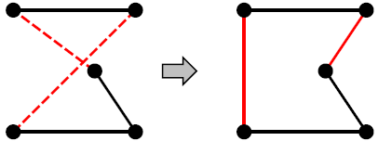
Example: Travelling Salesperson Problem
Start with any complete tour, perform pairwise exchanges
Variants of this approach get within 1% of optimal very quickly with thousands of cities

Slide 48
Example: Travelling Salesperson Problem
An operator is needed to transform one solution to another.
What operators work for TSP?
two-swap (common)
take two cities and swap their location in the tour
e.g. A – B – C – D – E swap(A, D) yields D – B – C – A – E
two-interchange
reverse the path between two cities
e.g. A – B – C – D – E interchange(A, D) yields D – C – B – A – E
both work since graph is fully connected

Slide 49
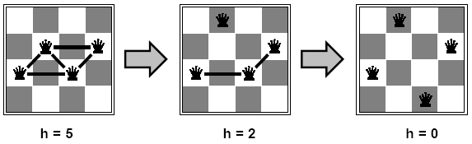
Example: n-queens
Put n queens on an n × n board with no two queens on the same row, column, or diagonal
Move a queen to reduce number of conflicts
Almost always solves n-queens problems almost instantaneously for very large n, e.g., n=1 million

Slide 50
Hill-climbing search
"is a loop that continuously moves in the direction of increasing value”
It terminates when a peak is reached.
Hill climbing does not look ahead beyond the immediate neighbors of the current state.
Hill-climbing chooses randomly among the set of best successors, if there is more than one.
Hill-climbing a.k.a. greedy local search

Slide 51
Hill-climbing search
function HILL-CLIMBING(problem) return a state that is a local maximum
input: problem, a problem
local variables: current, a node.
neighbor, a node.
current ← MAKE-NODE(problem.INITIAL-STATE)
loop do
neighbor ← a highest valued successor of current
if neighbor. VALUE ≤ current.VALUE then return current.STATE
current ← neighbor

Slide 52
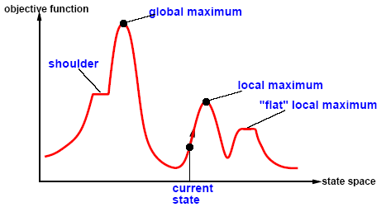
Hill-climbing search
Problem: depending on initial state, can get stuck in local maxima

Slide 53
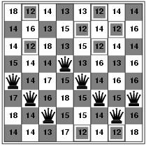
Hill-climbing search: 8-queens problem
h = number of pairs of queens that are attacking each other, either directly or indirectly
h = 17 for the above state

Slide 54
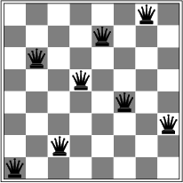
Hill-climbing search: 8-queens problem
A local minimum with h = 1

Slide 55
Hill-climbing variations
Stochastic hill-climbing
Random selection among the uphill moves.
The selection probability can vary with the steepness of the uphill move.
First-choice hill-climbing
implements stochastic hill climbing by generating successors randomly until one is generated that is better than the current state.
There are several ways we can try to avoid local optima and find more globally optimal solutions:
Random-restart hill-climbing
Simulated Annealing
Tabu Search

Slide 56
Simulated annealing search
Idea: escape local maxima by allowing some "bad" moves but gradually decrease their size and frequency
function SIMULATED-ANNEALING( problem, schedule) return a solution state
input: problem, a problem
schedule, a mapping from time to temperature
local variables: current, a node.
next, a node.
T, a "temperature" controlling the probability of downward steps
current ← MAKE-NODE(INITIAL-STATE[problem])
for t ← 1 to ∞ do
T ← schedule[t]
if T = 0 then return current
next ← a randomly selected successor of current
∆E ← VALUE[next] - VALUE[current]
if ∆E > 0 then current ← next
else current ← next only with probability e^{∆E /T}

Slide 57
Properties of simulated annealing search
One can prove:
If T decreases slowly enough, then simulated annealing search will find a global optimum with probability approaching 1
Widely used in VLSI layout, airline scheduling, etc

Slide 58
Local beam search
Keep track of k states rather than just one
Start with k randomly generated states
At each iteration, all the successors of all k states are generated
If any one is a goal state, stop; else select the k best successors from the complete list and repeat.

Slide 59
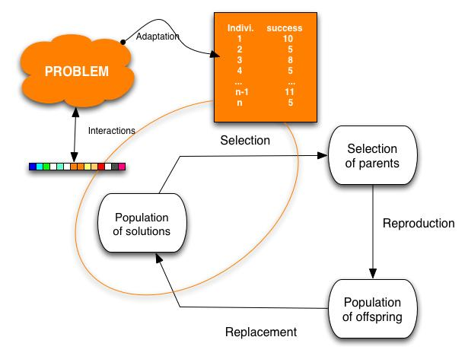
Genetic algorithms
Variant of local beam search with sexual recombination.

Slide 60
Genetic algorithms
A successor state is generated by combining two parent states
Start with k randomly generated states (population)
A state is represented as a string over a finite alphabet (often a string of 0s and 1s)
Evaluation function
fitness function – hàm đo độ thích nghi
Higher values for better states.
Produce the next generation of states by selection (chọn lọc), crossover (lai giống), and mutation (đột biến)

Slide 61
Genetic algorithms
Selection (Chọn lọc), use a fitness function to rank the individuals of the population
Reproduction (Sinh sản), define a crossover operator which takes state descriptions of individuals and combines them to create new ones
ways to choose crossover point(s) for reproduction:
Single-point: choose some “optimal” point in the state description, take the first half of one parent, the second half of the other.
Random: choose the split point randomly (or proportional to the parents’ fitness scores)
n-point: make not 1 split point, but n different ones
Uniform: choose each element of the state description independently, at random (or proportional to fitness)
Mutation (Đột biến), merely choose individuals in the population and alter part of its state

Slide 62
Genetic algorithm
function GENETIC_ALGORITHM( population, FITNESS-FN) return an individual
input: population, a set of individuals
FITNESS-FN, a function which determines the quality of the individual
repeat
new_population ← empty set
loop for i from 1 to SIZE(population) do
x ← RANDOM_SELECTION(population, FITNESS_FN) y ← RANDOM_SELECTION(population, FITNESS_FN)
child ← REPRODUCE(x,y)
if (small random probability) then child ← MUTATE(child )
add child to new_population
population ← new_population
until some individual is fit enough or enough time has elapsed
return the best individual

Slide 63
Genetic algorithm: 8 Queens problem
Each state (individual) specify the positions of 8 queens, each in a column of 8 squares, each in the range from 1 to 8
Fitness function: number of non-attacking pairs of queens (min = 0, max = 8 × 7/2 = 28)
State:
Fitness value:
4 3 2 5 4 3 2 3

Slide 64
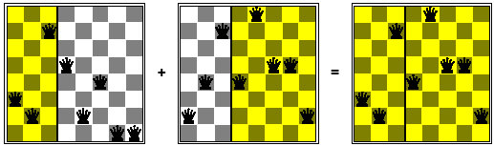
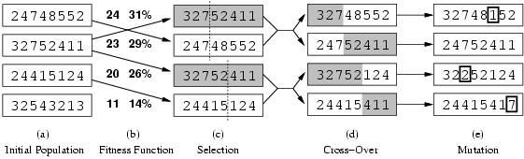
Genetic algorithms
Fitness function:
24/(24+23+20+11) = 31%
23/(24+23+20+11) = 29% etc

Slide 65
Local search in continuous spaces
Discrete vs. continuous environments
Successor function produces infinitly many states.
How to solve?
Discretize the neighborhood of each state .
Use gradient information to direct the local search method.
The Newton-rhapson method

Slide 66
Exploration problems
Until now all algorithms were offline.
Offline= solution is determined before executing it.
Online = interleaving computation and action
Online search is necessary for dynamic and semi-dynamic environments
It is impossible to take into account all possible contingencies.
Used for exploration problems:
Unknown states and actions.
e.g. any robot in a new environment, a newborn baby,…

Slide 67
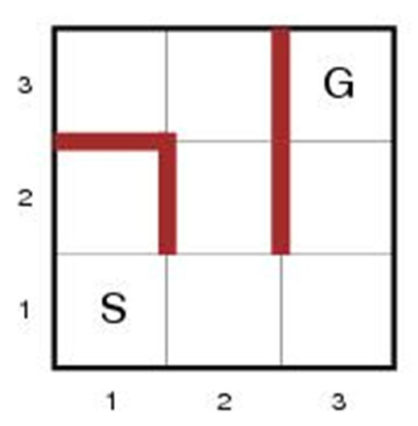
Online search problems
Agent knowledge:
ACTION(s): list of allowed actions in state s
C(s, a, s’): step-cost function (! After s’ is determined)
GOAL-TEST(s)
An agent can recognize previous states.
Actions are deterministic.
Access to admissible heuristic h(s).
E.g. manhattan distance

Slide 68
Online search problems
Objective: reach goal with minimal cost
Cost = total cost of travelled path
Competitive ratio = comparison of cost with cost of the solution path if search space is known.
Can be infinite in case of the agent accidentally reaches dead ends

Slide 69
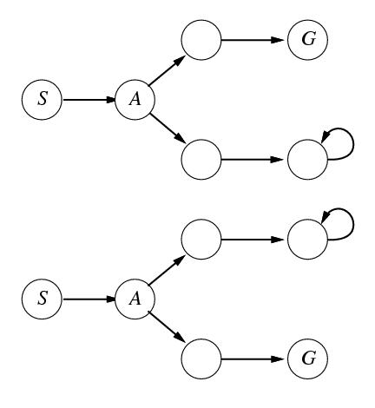
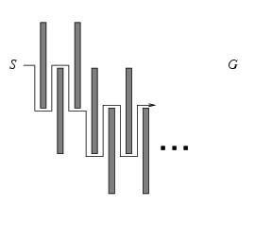
The adversary argument
Assume an adversary who can construct the state space while the agent explores it
Visited states S and A. What next? Fails in one of the state spaces
No algorithm can avoid dead ends in all state spaces.

Slide 70
Online search agents
The agent maintains a map of the environment.
Updated based on percept input.
This map is used to decide next action.
Note difference with e.g. A*
An online version can only expand the node it is physically in (local order)

Slide 71
Online DF-search
function ONLINE_DFS-AGENT(s’) return an action
input: s’, a percept identifying current state
static: result, a table indexed by action and state, initially empty
unexplored, a table that lists for each visited state, the action not yet tried
unbacktracked, a table that lists for each visited state, the backtrack not yet tried
s, a, the previous state and action, initially null
if GOAL-TEST(s’) then return stop
if s’ is a new state then unexplored[s’] ← ACTIONS(s’)
if s is not null then do
result[a, s] ← s’
add s to the front of unbackedtracked[s’]
if unexplored[s’] is empty then
if unbacktracked[s’] is empty then return stop
else a ← an action b such that result[b, s’]=POP(unbacktracked[s’])
else a ← POP(unexplored[s’])
s ← s’
return a

Slide 72
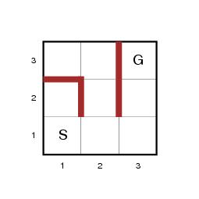
Online DF-search, example
Assume maze problem on 3x3 grid.
s’ = (1, 1) is initial state
Result, unexplored (UX), unbacktracked (UB), … are empty
S, a are also empty

Slide 73
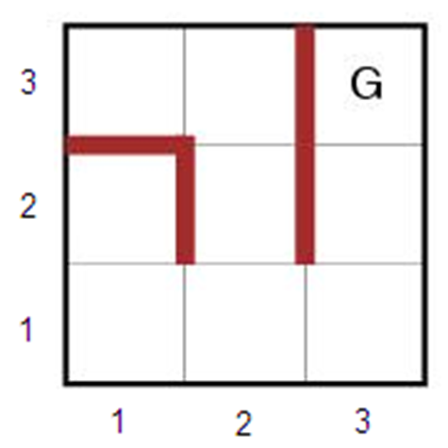
Online DF-search, example
GOAL-TEST((,1,1))?
S not = G thus false
(1,1) a new state?
True
ACTION((1,1)) -> UX[(1,1)]
{RIGHT,UP}
s is null?
True (initially)
UX[(1,1)] empty?
False
POP(UX[(1,1)])->a
a=UP
s = (1,1)
Return a
S’=(1,1)
S

Slide 74
Online DF-search, example
GOAL-TEST((2,1))?
S not = G thus false
(2,1) a new state?
True
ACTION((2,1)) -> UX[(2,1)]
{DOWN}
s is null?
false (s=(1,1))
result[UP,(1,1)] <- (2,1)
UB[(2,1)]={(1,1)}
UX[(2,1)] empty?
False
A=DOWN, s=(2,1) return A
S’=(2,1)
S

Slide 75
Online DF-search, example
GOAL-TEST((1,1))?
S not = G thus false
(1,1) a new state?
false
s is null?
false (s=(2,1))
result[DOWN,(2,1)] <- (1,1)
UB[(1,1)]={(2,1)}
UX[(1,1)] empty?
False
A=RIGHT, s=(1,1) return A
S’=(1,1)
S

Slide 76
Online DF-search, example
GOAL-TEST((1,2))?
S not = G thus false
(1,2) a new state?
True, UX[(1,2)]={RIGHT,UP,LEFT}
s is null?
false (s=(1,1))
result[RIGHT,(1,1)] <- (1,2)
UB[(1,2)]={(1,1)}
UX[(1,2)] empty?
False
A=LEFT, s=(1,2) return A
S’=(1,2)
S

Slide 77
Online DF-search, example
GOAL-TEST((1,1))?
S not = G thus false
(1,1) a new state?
false
s is null?
false (s=(1,2))
result[LEFT,(1,2)] <- (1,1)
UB[(1,1)]={(1,2),(2,1)}
UX[(1,1)] empty?
True
UB[(1,1)] empty? False
A= b for b in result[b,(1,1)]=(1,2)
B=RIGHT
A=RIGHT, s=(1,1) …
S’=(1,1)
S

Slide 78
Online DF-search
Worst case each node is visited twice.
An agent can go on a long walk even when it is close to the solution.
An online iterative deepening approach solves this problem.
Online DF-search works only when actions are reversible.
S

Slide 79
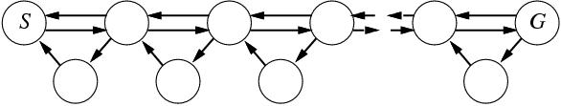
Online local search
Hill-climbing is already online
One state is stored.
Bad performancd due to local maxima
Random restarts impossible.
Solution: Random walk introduces exploration (can produce exponentially many steps)

Slide 80
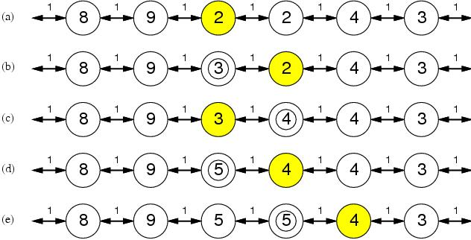
Online local search
Solution 2: Add memory to hill climber
Store current best estimate H(s) of cost to reach goal
H(s) is initially the heuristic estimate h(s)
Afterward updated with experience (see below)
Learning real-time A* (LRTA*)

Slide 81
Learning real-time A*
function LRTA*-COST(s,a,s’,H) return an cost estimate
if s’ is undefined the return h(s)
else return c(s,a,s’) + H[s’]
function LRTA*-AGENT(s’) return an action
input: s’, a percept identifying current state
static: result, a table indexed by action and state, initially empty
H, a table of cost estimates indexed by state, initially empty
s,a, the previous state and action, initially null
if GOAL-TEST(s’) then return stop
if s’ is a new state (not in H) then H[s’] ← h(s’)
unless s is null
result[a,s] ← s’
H[s] ← MIN LRTA*-COST(s,b,result[b,s],H)
b ∈ ACTIONS(s)
a ← an action b in ACTIONS(s’) that minimizes LRTA*-COST(s’,b,result[b,s’],H)
s ← s’
return a

